Slide 1
Module 3: Individual Peacekeeping Personnel
Lesson
3.3
Conduct and Discipline

Slide 2
Relevance
Peacekeeping personnel:
Ambassadors of the UN
Highest standards of behaviour and integrity
No sexual violence or exploitation
UN Core Pre-Deployment Training Materials 2017

Slide 3
Learning Outcomes
Learners will:
List three key principles of conduct
Describe categories of misconduct
Explain consequences of misconduct for victims, peacekeeping personnel and the mission
List key entities addressing conduct and discipline
UN Core Pre-Deployment Training Materials 2017

Slide 4
Lesson Overview
Conduct
Misconduct
Consequences of Misconduct
Reporting Misconduct
What Individual Peacekeeping Personnel Can Do
UN Core Pre-Deployment Training Materials 2017

Slide 5
Learning Activity
3.3.1
Film: Perceptions of UN Peacekeeping Personnel
Instructions:
Watch the long version of UN Peacekeeping Is
Consider the media coverage of UN personnel
How do the positive and negative images of personnel affect the image of the UN?
Time: 15 minutes
Film: 3:10 minutes
Group work: 5-7 minutes
https://youtu.be/egjBqs3o6XY
UN Core Pre-Deployment Training Materials 2017
Notes:
Pictures/ headlines – positive and negative
UN peacekeepers sexually exploited hundreds of Haitian women to have sex with them in return for food and medicine”. (A) report found exploitation is widespread, with a third of victims under-18 (Daily Mail, UK, June 2015)
U.N. Official to Visit Central African Republic Amid Scrutiny Over Peacekeepers. Zeid Ra’ad al-Hussein, the United Nations’ top human rights official, is to meet with the new acting leader of the peacekeeping mission, which has been roiled by sexual abuse allegations (New York Times, August 2015)
UN peacekeepers ‘traded gold and guns with Congolese rebels’ (The Guardian, UK, 2008)

Slide 6
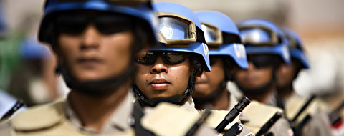
1. Conduct
Your conduct represents the UN
UN Core Pre-Deployment Training Materials 2017

Slide 7
UN Standards of Conduct
Three principles underpin UN standards of conduct:
Highest standards of efficiency, competence and integrity
Zero tolerance policy on sexual exploitation and abuse (SEA)
Accountability of those in command or authority who fail to enforce the standards of conduct
UN Core Pre-Deployment Training Materials 2017

Slide 8
Code of Conduct for Peacekeeping Personnel
UN Charter – highest standards of integrity and conduct
International Human Rights Law, International Humanitarian Law – fundamental basis for standards
Public and private life – pursue ideals of the UN
UN Core Pre-Deployment Training Materials 2017

Slide 9
Immunities & Privileges
To enable you to perform functions
May be waived by Secretary-General when in the interests of the UN
Does not mean that those who violate standards of conduct will get away with it
UN Core Pre-Deployment Training Materials 2017

Slide 10
2. Misconduct
Definition of Misconduct
Defined differently for different categories of peacekeeping personnel
All build on the same three principles of the UN standards of conduct
UN Core Pre-Deployment Training Materials 2017

Slide 11
Definition of Misconduct
For Civilian Personnel
Failure by a staff member to: Comply with his/her obligations under UN Charter, Staff Regulations and Rules and relevant Administrative issuances Observe Standards of Conduct expected of an international civil servant Reference: Staff Rule 310.1 Principles are also binding on other civilians in peacekeeping operations
UN Core Pre-Deployment Training Materials 2017

Slide 12
Definition of Misconduct
For Members of National Contingent and Military Staff Officers
Misconduct means any act or omission that is a violation of UN standards of conduct, mission-specific rules and regulations or the obligations towards national and local laws and regulations in accordance with the status-of-forces agreement where the impact is outside the national contingent. Serious Misconduct is misconduct, including criminal acts, that results in, or is likely to result in serious loss, damage or injury to an individual or to a mission. Sexual exploitation and abuse constitute serious misconduct. Reference: We are the UN Peacekeeping Personnel (lists specific instances)
UN Core Pre-Deployment Training Materials 2017
Notes:
Can we simply list definition of misconduct as two bullet points?

Slide 13
Definition of Misconduct
For UN Police and Military Observers
Minor Misconduct: any act, omission or negligence that is a violation of mission standard operating procedures (SOPs), directives or any other applicable rules, regulations or administrative instructions, but which does not result in or is not likely to result in major damage or injury to an individual or the mission. Serious Misconduct: any act, omission or negligence, including criminal acts, that is a violation of mission SOPs, directives or any other applicable rules, regulations or administrative instructions, that results in or is likely to result in serious damage or injury to an individual or to the mission. Reference: Directives for Disciplinary Matters involving Civilian Police Officers and Military Observers (lists specific instances)
UN Core Pre-Deployment Training Materials 2017
Notes:
Can we simply list types of misconduct as two bullet points?

Slide 14
Categories of Misconduct
Category I: Serious Misconduct includes:
Sexual exploitation and abuse (SEA)
Criminal activities, e.g. offences against the person, offences against property, including fraud
Category II: Misconduct includes:
Simple theft and fraud
Sexual or other work-related harassment
Traffic-related incidents, e.g. speeding
UN Core Pre-Deployment Training Materials 2017

Slide 15
Learning Activity
3.3.2
Consequences of Misconduct
Instructions:
Consider the negative media coverage
What are the consequences for victims?
What are the consequences for the mission?
What are the consequences for personnel?
Time: 5 minutes
Brainstorming: 3 minutes
Discussion: 2 minutes
UN Core Pre-Deployment Training Materials 2017
Notes:
Pictures/ headlines
UN peacekeepers sexually exploited hundreds of Haitian women to have sex with them in return for food and medicine”. (A) report found exploitation is widespread, with a third of victims under-18 (Daily Mail, UK, June 2015)
U.N. Official to Visit Central African Republic Amid Scrutiny Over Peacekeepers. Zeid Ra’ad al-Hussein, the United Nations’ top human rights official, is to meet with the new acting leader of the peacekeeping mission, which has been roiled by sexual abuse allegations (New York Times, August 2015)
UN peacekeepers ‘traded gold and guns with Congolese rebels’ (The Guardian, UK, 2008)

Slide 16
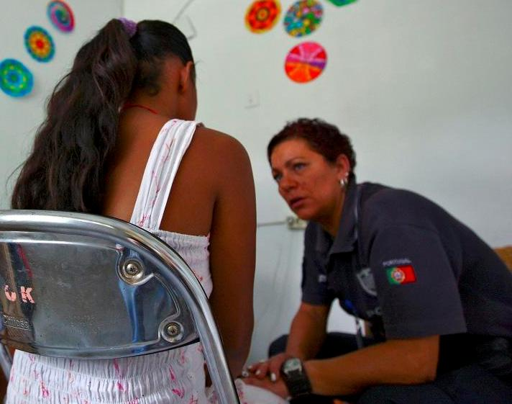
3. Consequences of Misconduct
For the Victim
Violates victim’s human rights
Can involve physical injury, financial loss, property damage or loss
Psychological and emotional effects
May affect family and local community
UN Core Pre-Deployment Training Materials 2017

Slide 17
For the Mission
Violates human rights
Undermines UN principles
Violates integrity and impartiality
Reduces credibility and image of UN
Threatens security
Undermines rule of law and fosters crime
UN Core Pre-Deployment Training Materials 2017

Slide 18
For Peacekeeping Personnel
Disciplinary action
Repatriation/barring from future service
Summary dismissal
Criminal proceedings
Financial liability
UN Core Pre-Deployment Training Materials 2017

Slide 19
4. Reporting Misconduct
Key Entities
Conduct and Discipline Unit (CDU)
Office of the Internal Oversight Services (OIOS)
Ethics Office
UN Ombudsman
UN Core Pre-Deployment Training Materials 2017

Slide 20
Reporting Duties for Personnel
Report suspected misconduct
Report in good faith supported by evidence
Cooperate with UN investigations
Make reports to UN officials, OIOS or to others in special circumstances
Report misconduct directly to OIOS without a need for supervisory approval (ST/SGB/273, para 18)
UN Core Pre-Deployment Training Materials 2017

Slide 21
Protection from Retaliation
Retaliation: direct or indirect detrimental action recommended, threatened or taken against a person who reports misconduct
Retaliation can be reported
UN Core Pre-Deployment Training Materials 2017

Slide 22
Learning Activity
3.3.3
Promoting Good Conduct
Instructions:
Consider your conduct as UN personnel
What do you need to remember?
Design a poster to put up in the mission as a reminder
Time: 10 minutes
Group work: 5-7 minutes
Discussion: 3 minutes
UN Core Pre-Deployment Training Materials 2017
Notes:
Pictures

Slide 23
5. What Individual Peacekeeping Personnel Can Do
Individual Responsibility
You are an ambassador of the UN
Follow UN Charter, IHRL, IHL, UN specific rules, regulations and guidance
You have a duty to report misconduct, cooperate in investigations, provide information in good faith
UN Core Pre-Deployment Training Materials 2017

Slide 24
Leadership and Accountability
Maintain standards of conduct
Prevent, monitor and respond to misconduct
Ensure misconduct prevention training
Conduct periodic misconduct risk assessments
Report all misconduct to CDU or OIOS
UN Core Pre-Deployment Training Materials 2017

Slide 25
Summary of Key Messages
Key principles of conduct – high standards, zero tolerance of SEA, leadership accountability
Categories of misconduct – category 1 serious misconduct offences (high risk), category 2 misconduct offences (low risk)
Serious consequences of misconduct for peacekeeping personnel, host population and mission
Key entities for conduct and discipline – CDU, OIOS, Ethics Office, UN Ombudsman
UN Core Pre-Deployment Training Materials 2017

Slide 26
Questions
UN Core Pre-Deployment Training Materials 2017

Slide 27
Learning Activity
Learning Evaluation
UN Core Pre-Deployment Training Materials 2017

